Slide 1

Master of Applied Data Science Portfolio Presentation
N’Dea Jackson
Syracuse University
Spring 2021
Notes:
Greetings. My name is N’Dea Jackson and I am a Spring 2021 candidate for a Masters of Applied Data Science here at Syracuse University. Today, I will be presenting my portfolio as a requirement of completion of the program.

Slide 2
Introduction
The Applied Data Science program at Syracuse University is offered jointly by the School of Information Studies and the Martin J. Whitman School of Management. This Master of Applied Data Science degree program is designed to be a professional program of study, with a strong emphasis on the applications of data science to enterprise operations and processes, particularly in the areas of data capture, management, analysis, and communication for decision making.
The courses that were chosen to represent the learning objectives of the Masters of Applied Data Science Program were:
IST 659: Database Administration
IST 719: Data Visualization
IST 707: Data Analytics
MAR 653: Marketing Analytics
https://github.com/njacks01/AppliedDataSciencePortfolio
Notes:
To begin, the Applied Data Science Program at Syracuse University is offered as a joint program with the School of Information Studies and the Martin J. Whitman School of Management. This program focuses directly on applications of Data Science that can be applied to enterprise operations and processes, particularly in the areas of data capture, management, analysis, and communications for decision making.
As a requirement of the portfolio, I have selected several projects that I have worked on over the course of my degree that align with the program’s learning objectives, which I will detail in the next slide.

Slide 3
Master of Applied Data Science Program Learning Objectives
Describe a broad overview of the major practices in data science
Collect and organize data
Identify patterns in data visualization, statistical analysis, and data mining
Develop alternative strategies based on their data
Develop a plan of actions to implement the business decisions derived from the analyses
Demonstrate communication skills regarding data and its analysis for managers, IT professionals, programmers, statisticians, and other relevant professionals in their organization
Synthesize the ethical dimensions of data science practice (e.g., privacy)
Notes:
The Master of Applied Data Science program has 7 learning objectives that follow students throughout the span of their degree. Students should be able to tie these learning objectives to the works that they complete in all of their courses. The objectives can be seen on the right hand side of the screen.

Slide 4
IST 659 Database Administration Concepts and Management
Notes:
The first course I will be reviewing is IST 659 – Database Administration.

Slide 5
Jackson Memorial Hospital Database IST 659: Database Administration
Project overview:
Under the direction of Professor Chad Harper, a hospital database was designed for a fictitious hospital in the hopes of:
Providing the hospital with a better way to maintain all hospital records including:
Patient information
Doctor-Patient assignments
Patient room assignments
Patient invoice status
Overall benefit to the hospital:
Minimize paperwork
Eliminate siloed hospital systems
Increase level of patient care and staff efficiency
Language used: SQL
Learning Objectives Met:
Collect/Create and organize data
Develop alternative strategies for efficiency
Develop a plan of action to implement the business decisions derived from analysis
Demonstrate communication skills

Slide 6
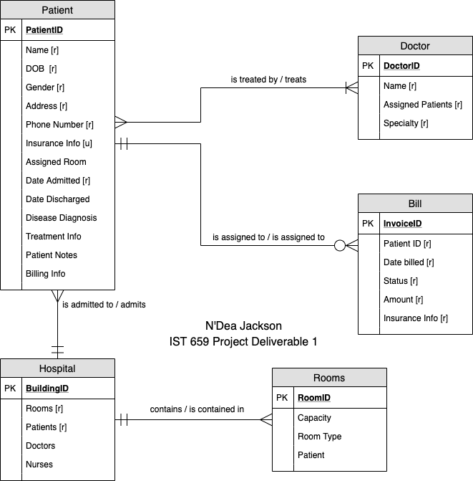
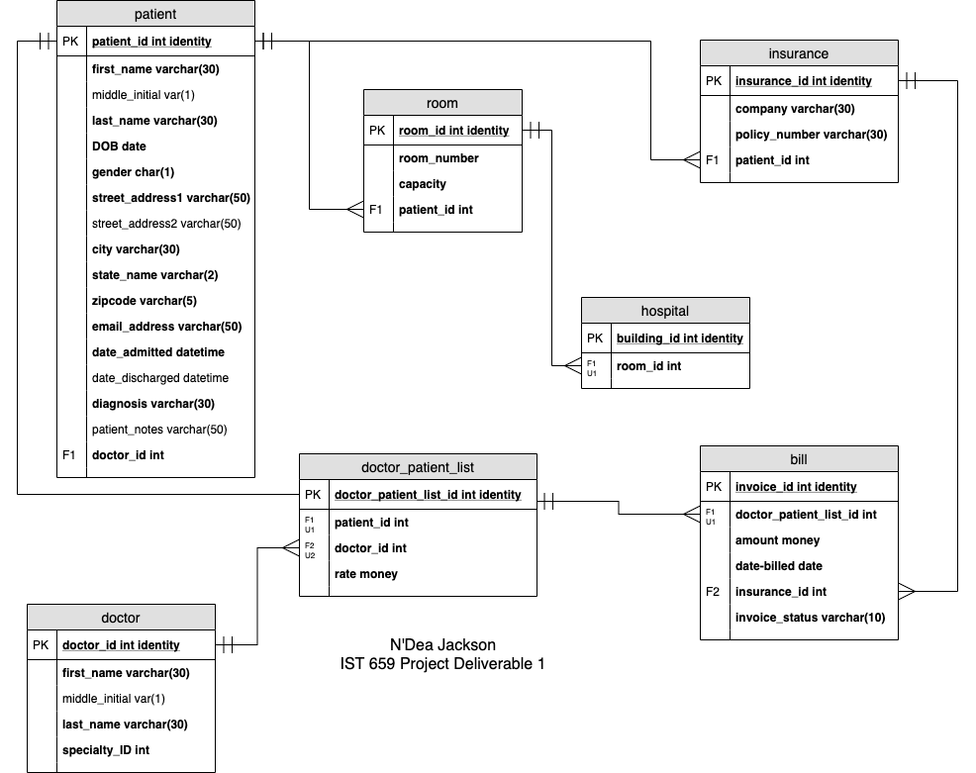

Slide 7
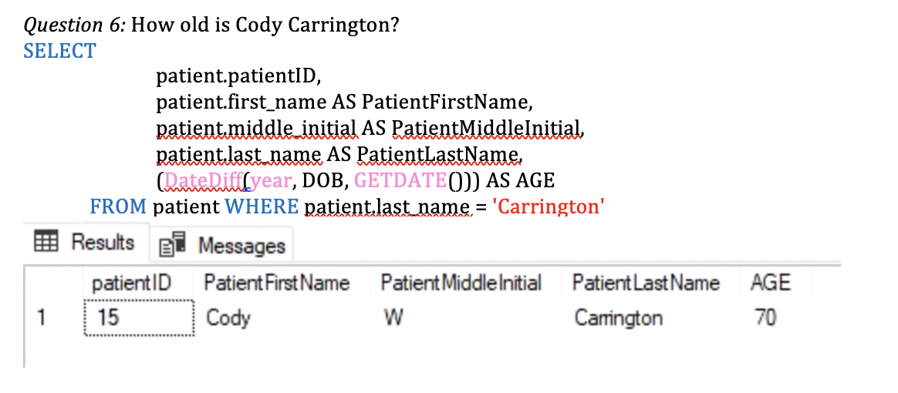
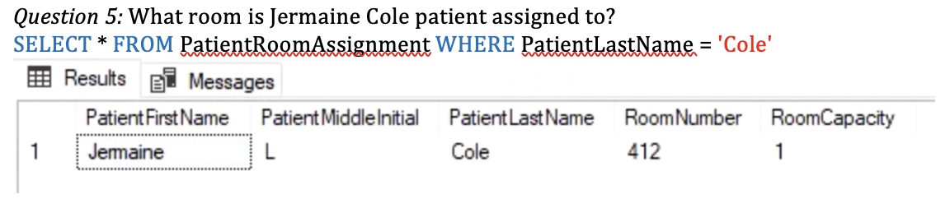
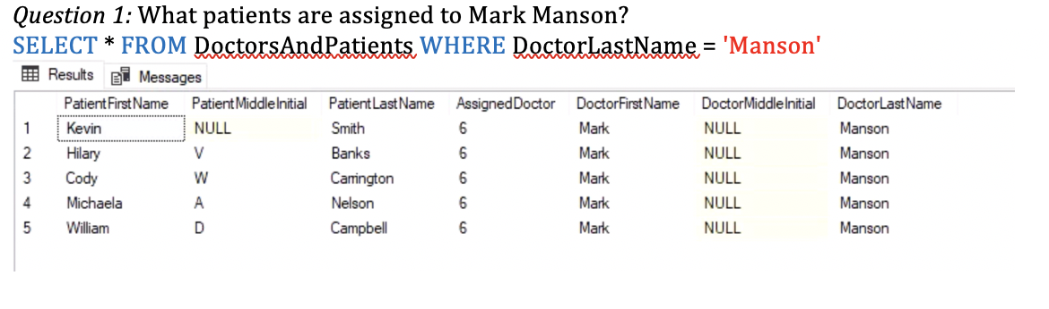
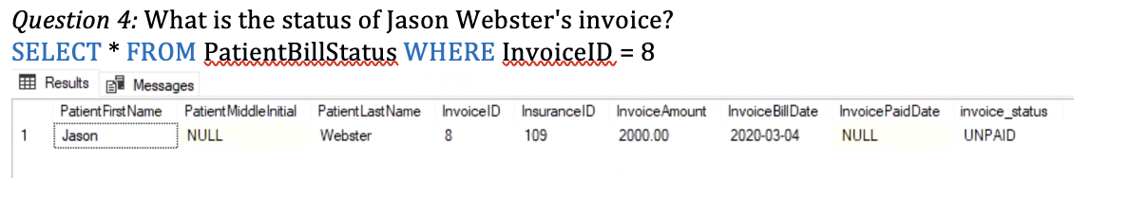

Slide 8
Reflection IST 659: Database Administration
Creating a database taught students the importance of relationship mapping as well as the importance of how data is stored.
Missing or misrepresented relationships can dramatically change the effectiveness of the database
Skills learned in this course are transferrable to the enterprise workforce as well as to future courses such as Advanced Database Management and Data Warehousing
Project allowed students practice with identifying stakeholders, creating questions relevant to the stakeholders chosen, and creating business rules to govern the relationships that existed.
Learning Objectives Met:
Collect/Create and organize data
Develop alternative strategies for efficiency
Develop a plan of action to implement the business decisions derived from analysis
Demonstrate communication skills

Slide 9
IST 719 Data Visualization

Slide 10
Boston Crime Data Report IST 719: Data Visualization
Project Overview:
Under the direction of Professor Gary Krudys, a poster visualization was designed in order to display the most prevalent crimes that occurred in Boston neighborhoods.
Overall benefit of the visualization:
Boston Police Department (BPD) would gain a better understanding of which neighborhoods could benefit from an increased police presence
City officials would gain a better understanding of programs they could place in certain areas to curb criminal activity
Making this data public would allow residents, potential residents, and visitors to be more aware of their surroundings
Language used: R
Learning Objectives Met:
Collect and organize data
Going a step further to identify patterns in the data via visualization and statistical techniques
Develop a plan of actions to implement the business decisions derived from the analyses
Demonstrate communication skills regarding the data
https://data.boston.gov/dataset/crime-incident-reports-august-2015-to-date-source-new-system

Slide 11
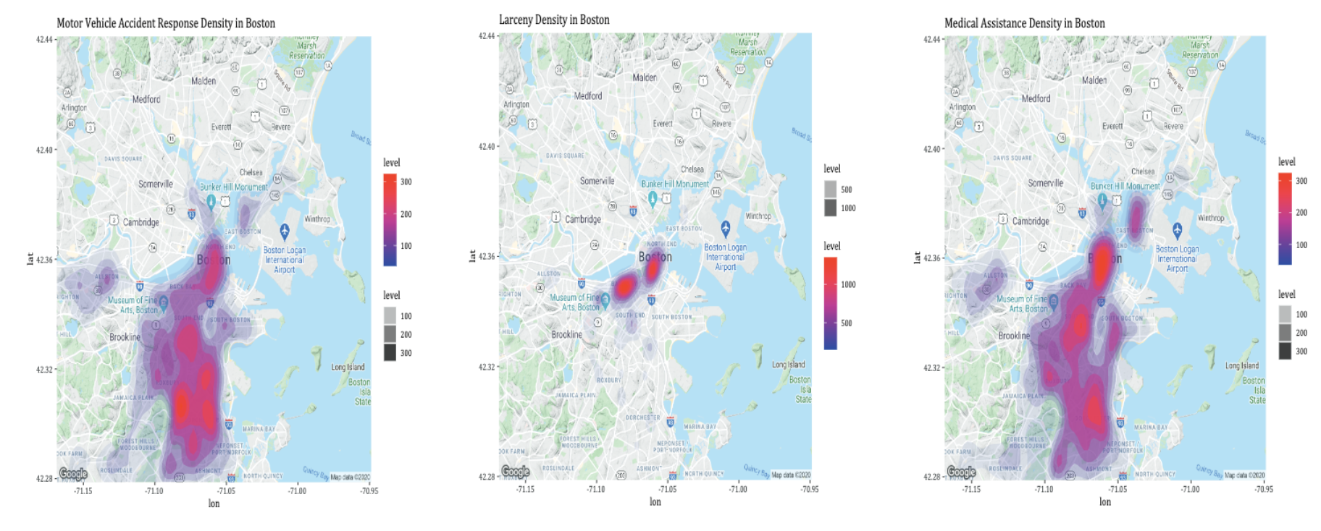
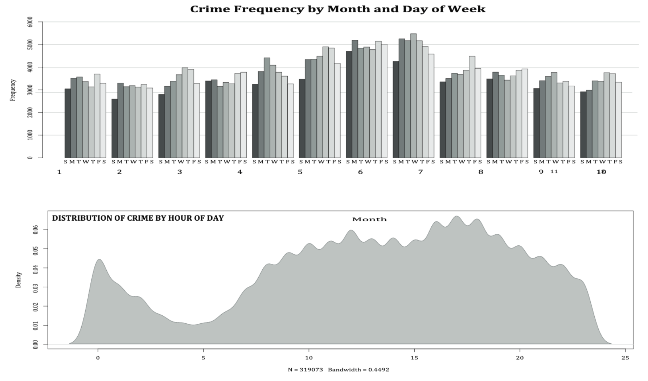
The Data IST 719: Data Visualization
What crimes occur most frequently?
Heat maps were created of the three most frequently occurring crimes that occur in Boston neighborhoods:
Motor Vehicle Accident Response
Larceny (including shoplifting, bicycles, purse snatches)
Medical Assistance (including sick/injured/medical/suicide attempt/sudden death/death investigation)
When do crimes occur?
Histograms and density plots were created to examine the frequency of crimes over the course of the four years being analyzed:
48,496 incidents were recorded on Fridays, making it the day of the week with the highest crime frequency
Over the course of a 24-hour period, crime appears to drop after midnight and steadily rise until it reaches its peak at 5PM.
Yearly, the summer months, May-August, crime rises.

Slide 12
Reflection IST 719: Data Visualization
This course allowed students the space to gain practical knowledge on how to use R to perform data cleaning and preparation on a wide range of datasets
Taught how to gain insights from data as well as how to effectively communicate findings through visualizations
Create visualizations that don’t compromise the data being presented
Accurately and effectively portray data
Sharpened communication skills by creating data stories and tailoring presentations to specific audiences
Skills learned in this course were transferrable to other courses throughout the program and are also extremely valuable in the workforce.
Learning Objectives Met:
Collect/Create and organize data
Develop alternative strategies for efficiency
Develop a plan of action to implement the business decisions derived from analysis
Demonstrate communication skills

Slide 13
IST 707 Data Analytics

Slide 14
National Basketball Association Shot Analysis IST 707: Data Analysis
Project Overview:
Under the direction of Professor Jeremy Bolton, various data mining, data preparation, and other relevant techniques were used to analyze shots that were taken by National Basketball Association (NBA) players.
Overall benefit of the analysis:
Help the league improve performance by predicting things such as whether a game would be won based on several factors
Drive fan satisfaction ratings in the tumultuous 2019-2020 season
Language used: R
Learning Objectives Met:
Collect and organize data
Identify patterns in the data via visualization and data mining
Develop alternative strategies based on the data used
Implement business decisions derived from the analyses
Demonstrate communication skills by reporting on findings with recommendations
https://www.kaggle.com/dansbecker/nba-shot-logs

Slide 15
Methodology
About the data
Methods and Results
NBA dataset that was scraped from the NBA’s REST API before it was made publicly unavailable.
The NBA uses a 6-camera system that can track 2-dimensional player locations 25 times per second.
After all data preparation, there were 281 unique player IDs represented across 1808 unique games.
Methods used:
Decision trees, association rule mining, support vector machines
SVM had the highest accuracy of predicting whether a shot would be made with 79.3%
Decision trees proved to have the highest accuracy of predicting whether a game would be won with 64.54%

Slide 16
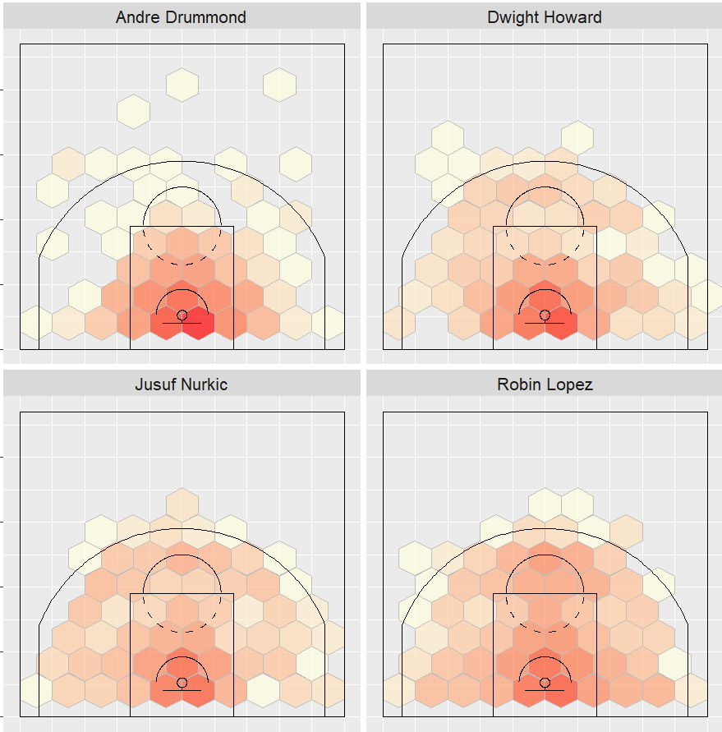
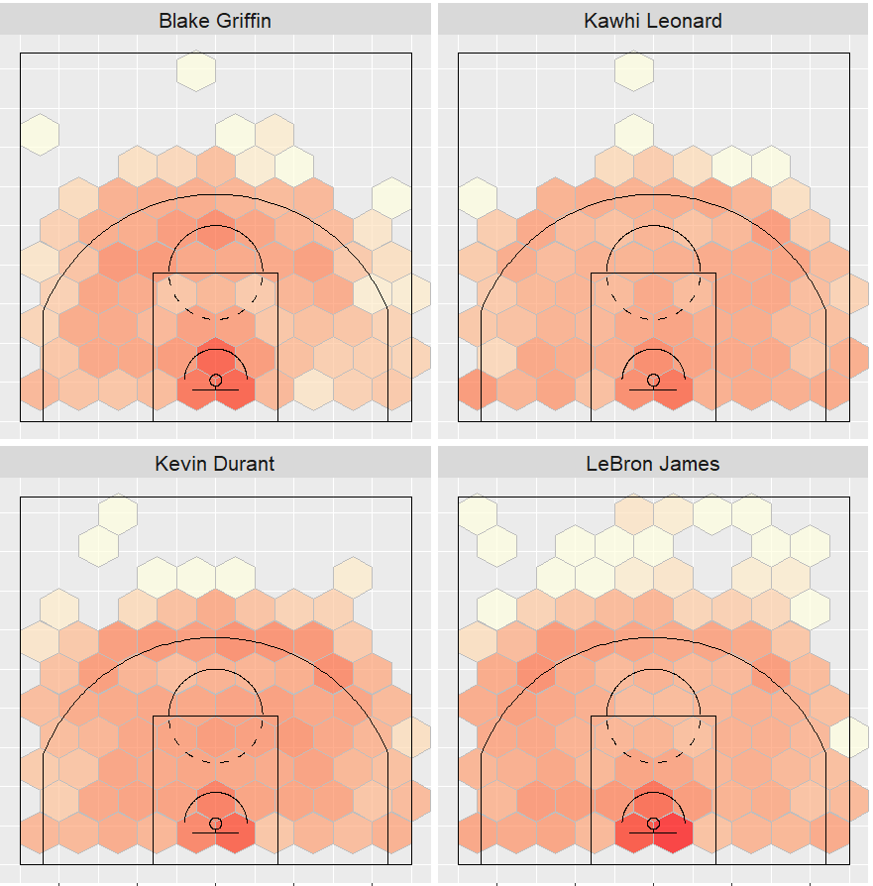
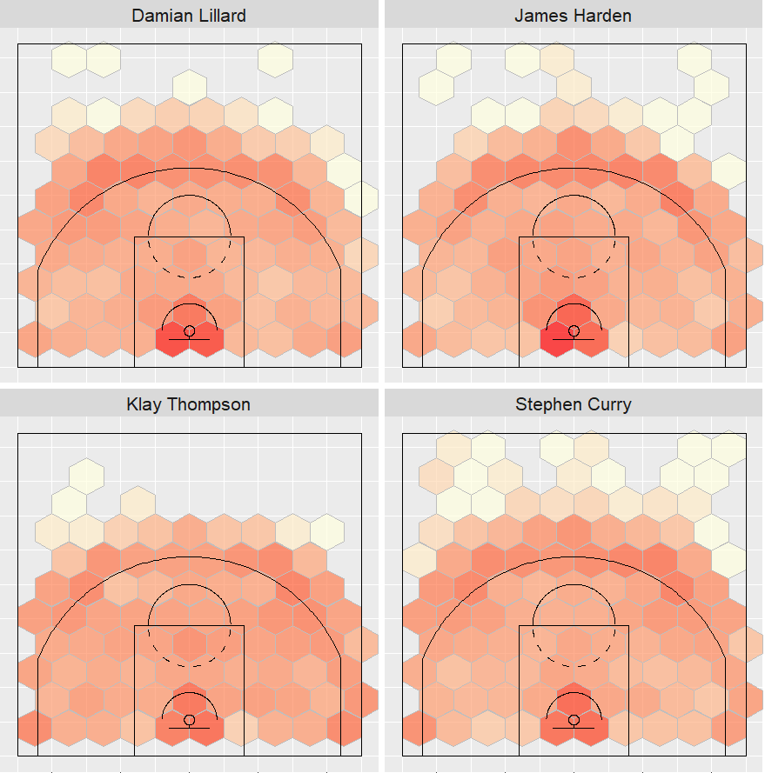
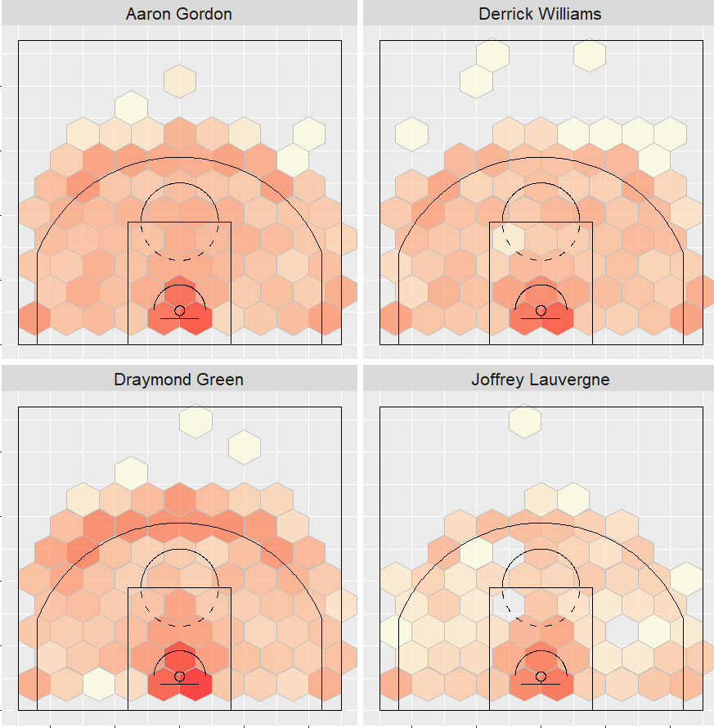
Methodology
Clustering was used in this project to determine the different player types that were represented within the data.
Four shooter types:
Lay-up range
Elbow range
3-Point range
Combination player

Slide 17
Reflection IST 707: Data Analysis
This course allowed students the opportunity to test various techniques to solve the same problem.
Highlights for students the strengths and weaknesses of various modeling techniques
Getting different results from different techniques shows the importance of testing multiple models before making business decisions
Using multiple solutions to solve the same problems can provide businesses with the most precise results and save costs down the line
Learning Objectives Met:
Collect and organize data
Identify patterns in the data via visualization and data mining
Develop alternative strategies based on the data used
Implement business decisions derived from the analyses
Demonstrate communication skills by reporting on findings with recommendations

Slide 18
MAR 653 Marketing Analytics

Slide 19
San Francisco Airport Data: Pandemic Recovery Survey MAR 653: Marketing Analytics
Project Overview:
Under the direction of Professor Shaam Ramamurthy, marketing strategies and quantitative analysis techniques were applied to the San Francisco Airport Survey dataset to determine which customers SFO should target for traveling improvements.
Overall benefit of the analysis:
Help the San Francisco Airport (SFO) determine which travelers may need more encouragement before feeling safe flying
Make recommendations to SFO to improve the passenger travel experience during the pandemic
Tools used: Python, Excel, Orange
Learning Objectives Met:
Collect and organize data
Identify patterns in the data via visualization and data mining
Develop alternative strategies based on the data used
Implement business decisions derived from the analyses
Demonstrate communication skills by reporting on findings with recommendations
https://www.flysfo.com/media/customer-survey-data

Slide 20
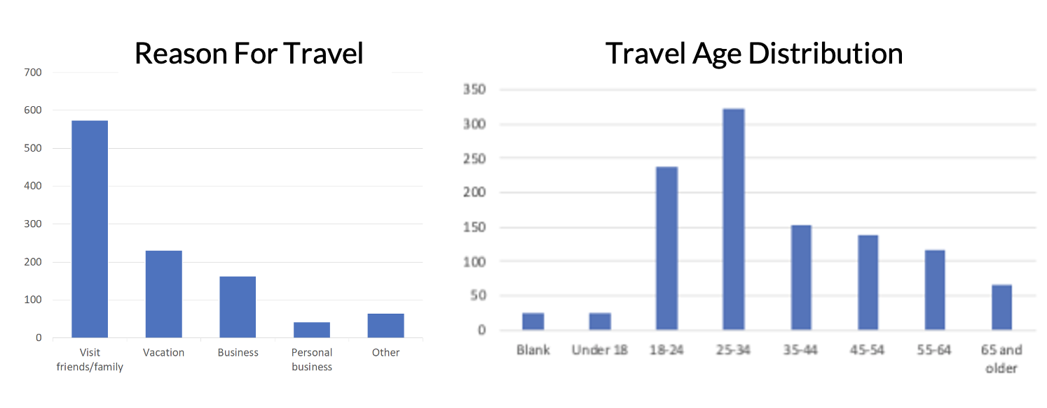
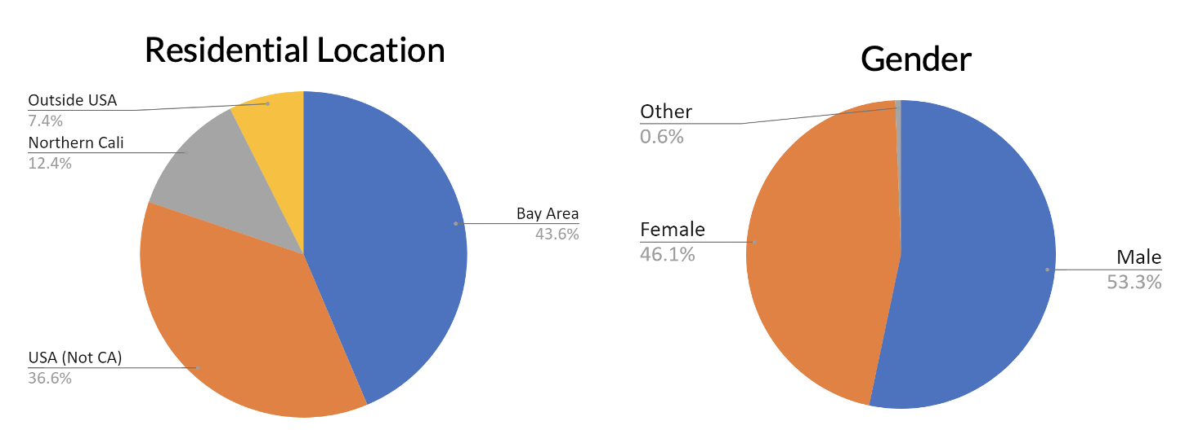
Methodology MAR 653: Marketing Analytics
About the data
Surveys were conducted on paper surveys within the SFO airport
1,086 participants
16 questions that collected information on traveler demographics and traveler comfortability.
Used by SFO to gauge satisfaction levels and travel preferences of travelers in hopes to remain above satisfactory

Slide 21
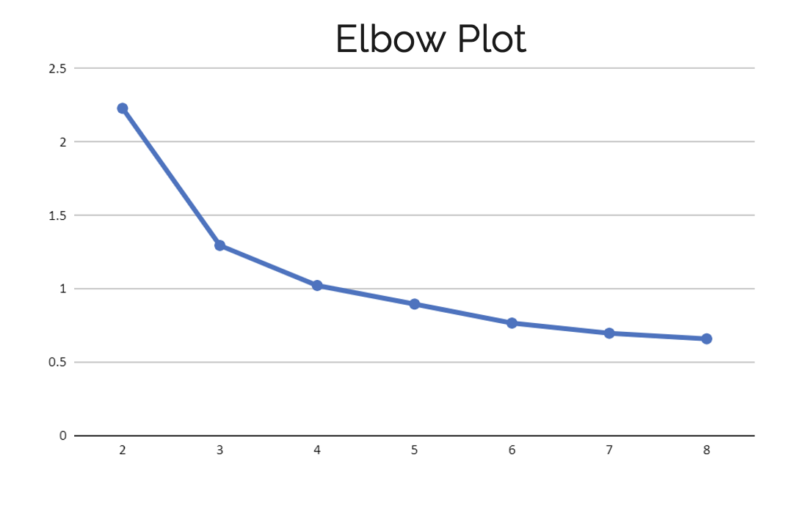
Methodology MAR 653: Marketing Analytics
K-Means clustering used to segment customers into groups that could be used by SFO. 3 clusters used.
Most important factors for travelers:
47% of travelers selected strict social distancing guidelines and enforcement.
14% of travelers selected having hand sanitizer readily available.
11% of travelers selected ensuring everyone was wearing a mask.

Slide 22
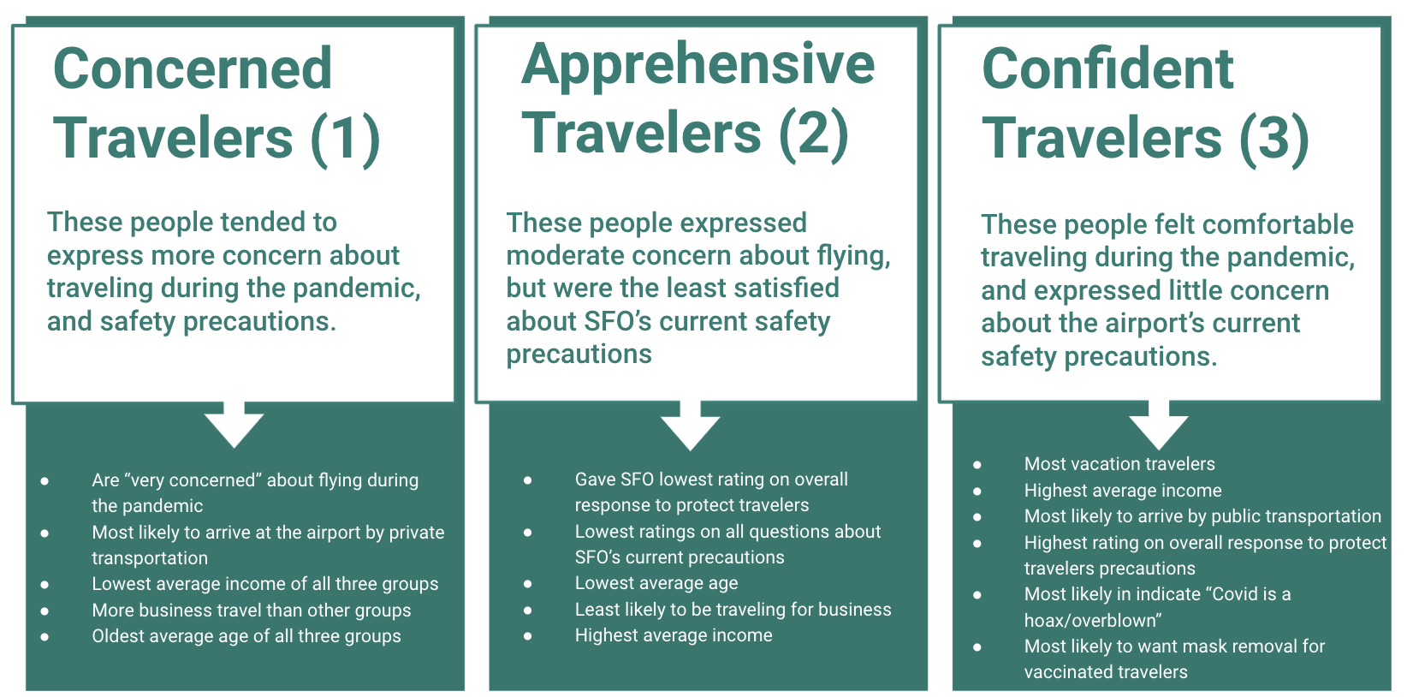

Slide 23
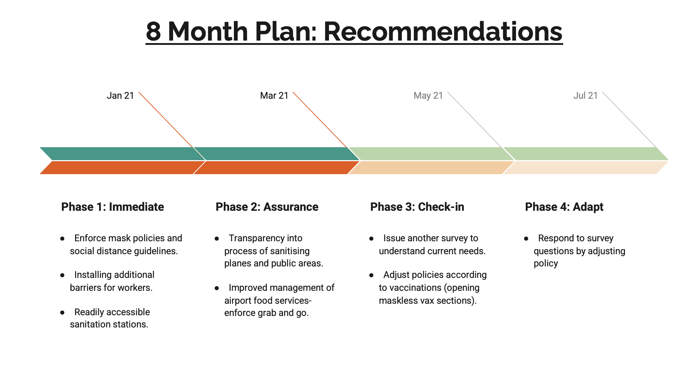
Recommendation MAR 653: Marketing Analytics
Which customers to target:
Very concerned about flying
Low ratings on current airport policies
Older people
Less likely to use public transportation
Why:
Alleviate tensions associated with resuming post pandemic travel.
Have SFO take extra precautions to meet the needs of the most vulnerable groups of people.

Slide 24
Reflection MAR 653: Marketing Analytics
This course allowed students the opportunity collect and organize data of their choosing to target a specific customer set and optimize some marketing goal.
Students were taught how to create various strategies to lead to the same outcome, improving client lifetime value.
Customer segmentation helps students to learn their audiences in hopes to provide more value.
Communication skills were further developed through group presentations
Learning Objectives Met:
Collect and organize data
Identify patterns in the data via visualization and data mining
Develop alternative strategies based on the data used
Implement business decisions derived from the analyses
Demonstrate communication skills by reporting on findings with recommendations

Slide 25
Recap of Learning Objectives
Describe a broad overview of the major practices in data science
Collect and organize data
Identify patterns in data visualization, statistical analysis, and data mining
Develop alternative strategies based on their data
Develop a plan of actions to implement the business decisions derived from the analyses
Demonstrate communication skills regarding data and its analysis for managers, IT professionals, programmers, statisticians, and other relevant professionals in their organization
Synthesize the ethical dimensions of data science practice (e.g., privacy)
This portfolio presentation shows the successful implementation and understanding of the learning objectives of the Masters of Applied Data Science program. The courses taken in this program compounded on each other and gradually increased in complexity.
Notes:
The Master of Applied Data Science program has 7 learning objectives that follow students throughout the span of their degree. Students should be able to tie these learning objectives to the works that they complete in all of their courses. The objectives can be seen on the right hand side of the screen.

Slide 26
Conclusion
The Applied Data Science program at Syracuse University is designed to be a professional program of study with a strong emphasis on the applications of data science to enterprise operations and processes, particularly in the areas of data capture, management, analysis, and communication for decision making.
The skills that students learn in the program provided them with many multifaceted approaches to dealing with both structured and unstructured data.
Students gained practical experience using several different languages and tools to solve real business problems including R, Python, Excel, SQL, and Microsoft Access.
Through several means including reports, oral presentations, poster creation, and this portfolio, students learned communication skills valuable for presenting to stakeholders and other specific audiences.
Through courses, students gained an understanding of both security and ethical boundaries in data.

Slide 27
Thank you!
https://github.com/njacks01/AppliedDataSciencePortfolio

